Slide 1
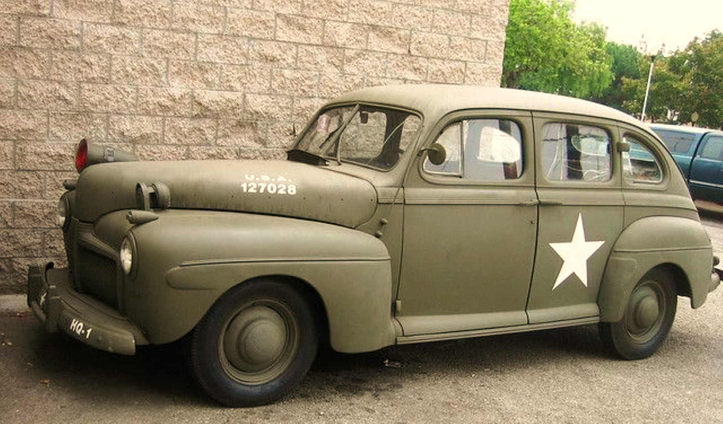


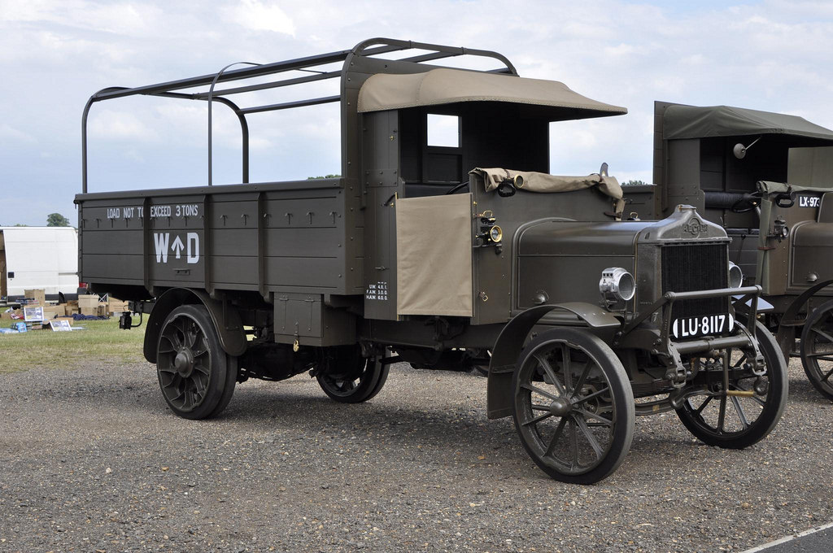
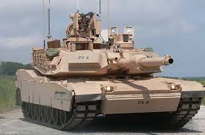
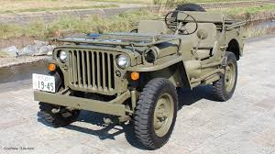

THE PAST, PRESENT AND FUTURE OF MILITARY VEHICLES
MILITARY
MACHINES
WORLD WAR ONE
GREAT WAR
RESTORATIONS
INTERNATIONAL
What’s being
rebuilt?
WARTIME WEEKEND
DIG FOR VICTORY
SHOW REPORT
ESSENTIAL
READING
Tank versus Anti-Tank
Exercise Cougar 12
Tatra Kolos Trucks
MODERN ARMOR
Wings over Wairarapa
CENTURION
Plus all the regular features
Britain’s finest MBT
BUYER’S GUIDE
AUGUST 2013- VOLUME 13 NO. 3
WHICH LAND ROVER WOULD YOU BUY?
KEY
USA $9.99
CAD $11.99
AUS $9.95
UK $4.25
MILITARY VRHICLES FROM THE BATTLEFIELD
WWW.MILITARYMACHINESINTL.COM

